Slide 1
Logo animation (intro)

Slide 2



Title slide
Geocafé
12 March 2024
Lucas Jellema

Slide 3
Agenda
Why?
Simple Maps, simple tools
Chloropleth, Point Map using Data Wrapper, Google MyMaps and StoryMap
Geo Data – coordinates, format and tool: geojson.io
Geo Data Sets – publicly available data describing location-bound characteristics
MapShaper for converting formats, inspecting and manipulating data
MapWarper – for georectifying custom images of maps (historic, fantasy or otherwise)
QGIS – geo data scientist’s workbench (all of the above and more)
Integrating custom, interactive, dynamic in web applications using Leaflet and OpenStreetMap
Conclusion real life example: Check the Beat 2.0 – CMC & ProRail – Oliver Heesakkers
demonstration of Conclusion FotoMapp
workshop materials: github.com/lucasjellema/geocafe
Notes:
MapWarper and QGIS https://spacetime.nypl.org/qgis-trace-tutorial/ - load georectified historical map as WMS Layer from WMS Capabilties URL in MapWarper
https://gisgeography.com/gis-formats/

Slide 4
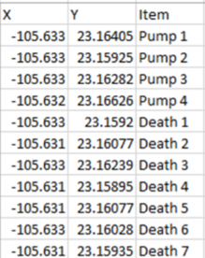
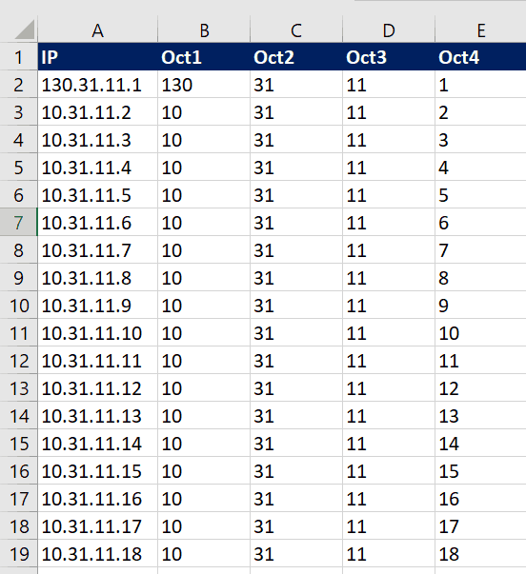
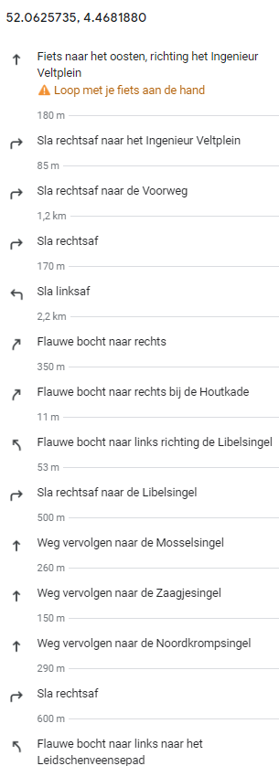
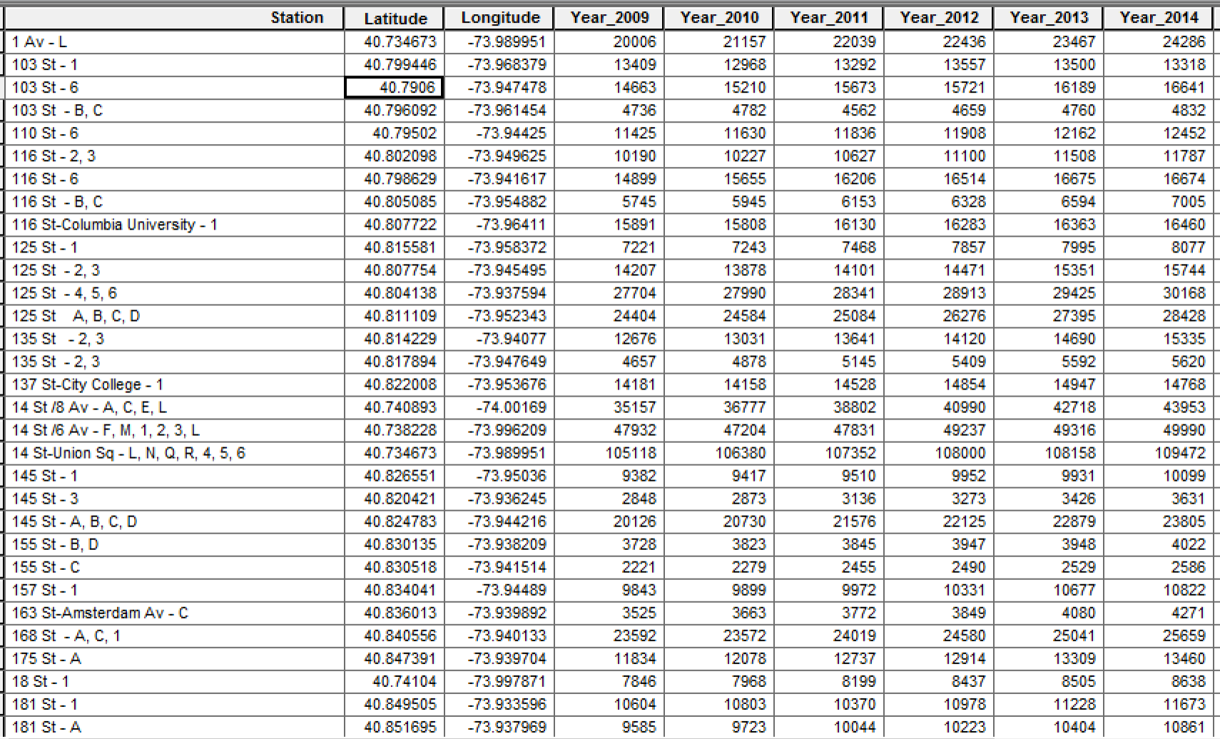
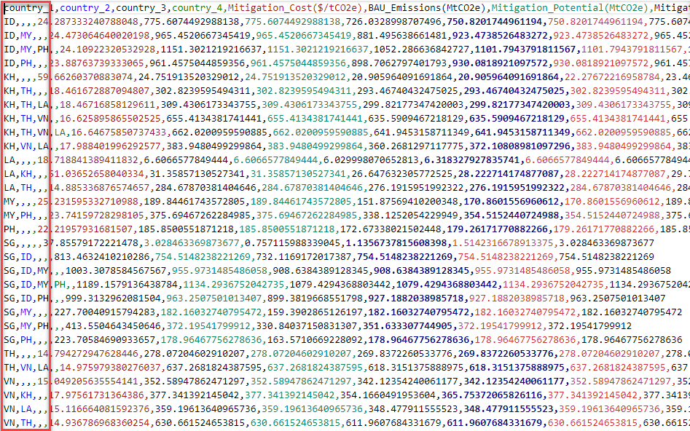
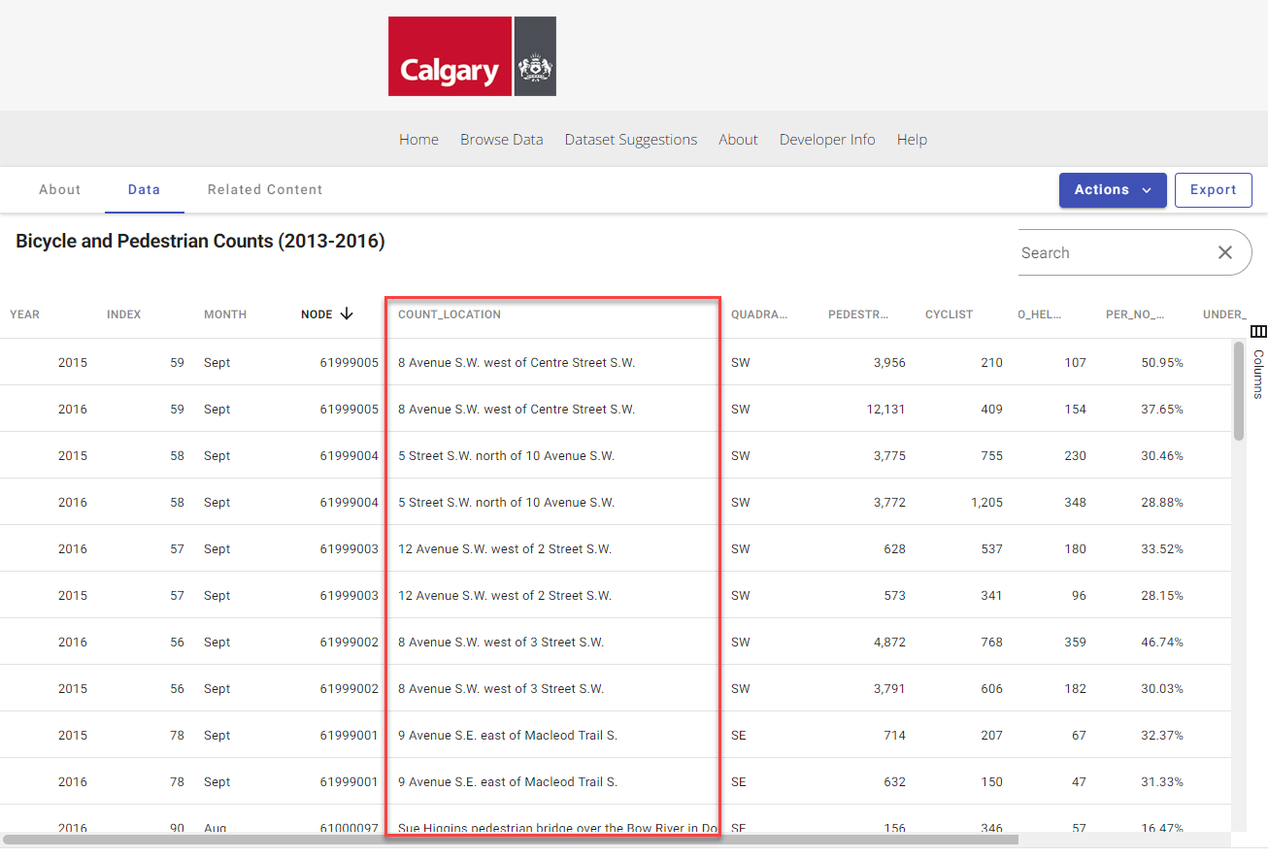
Geo related data

Slide 5
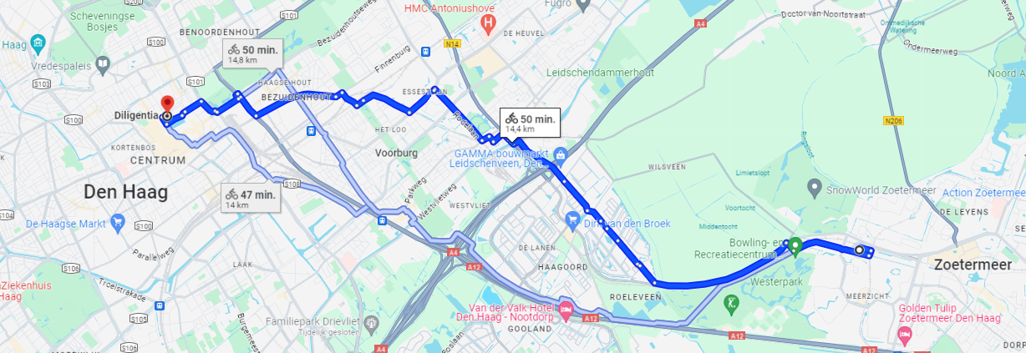
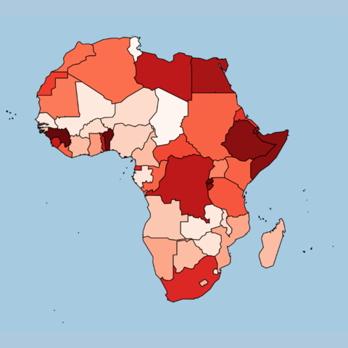
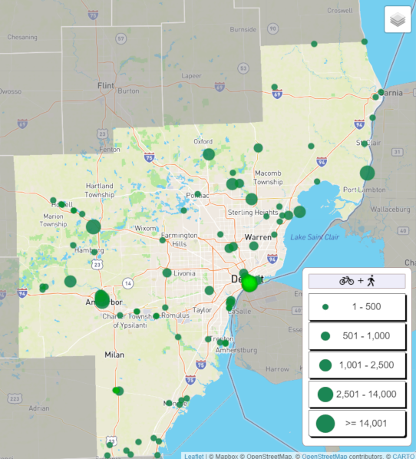
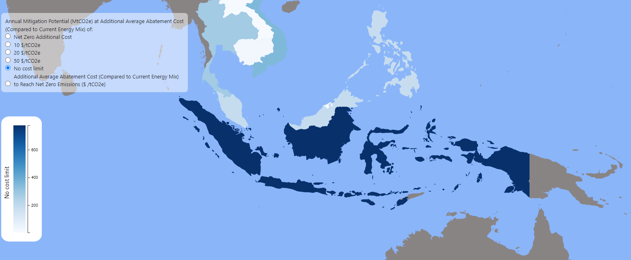
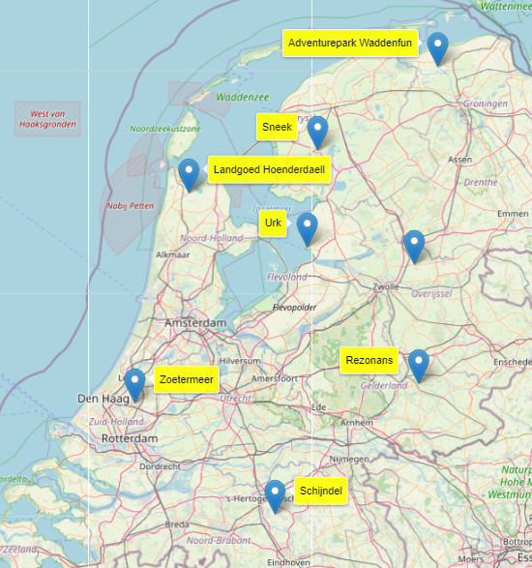
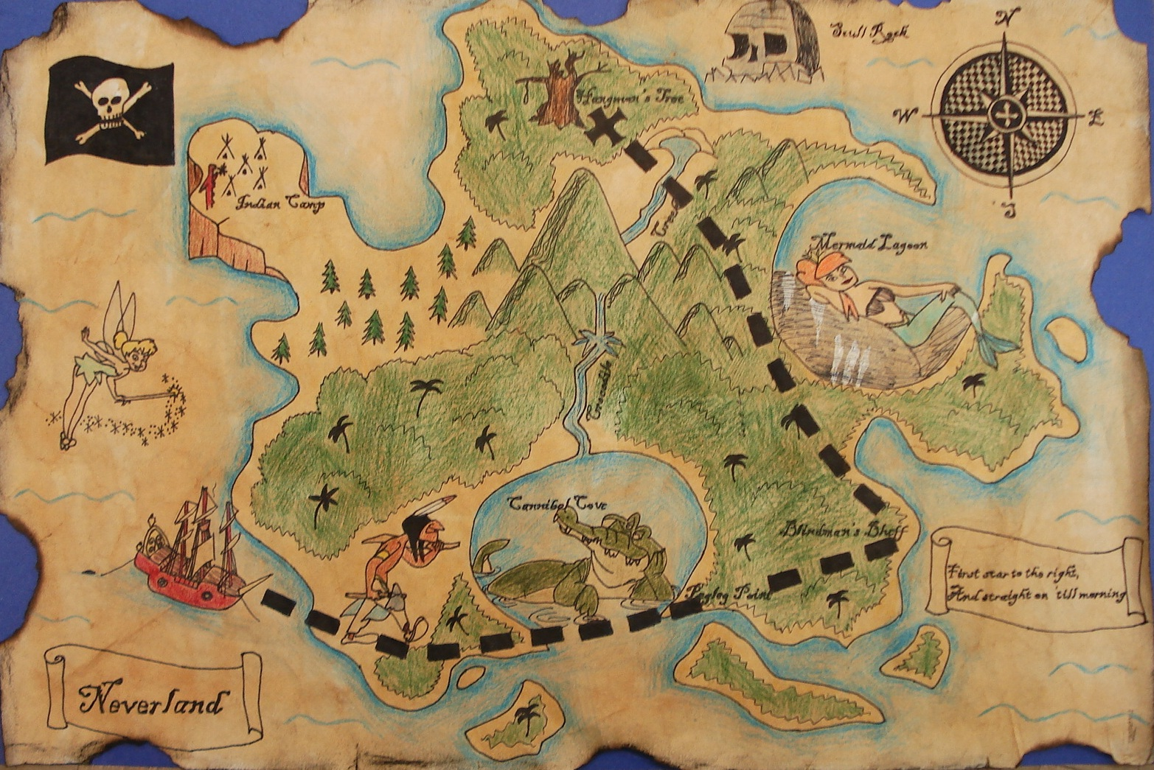

Slide 6
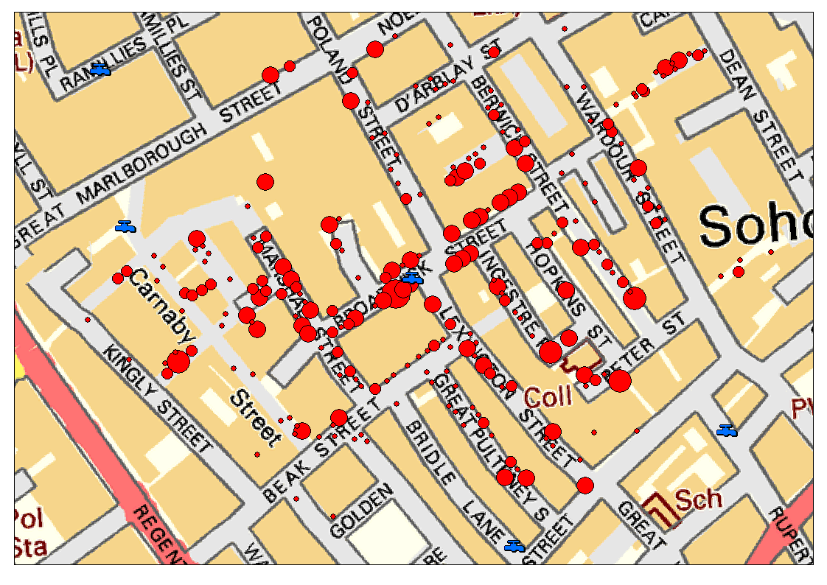
from data to map to insight to action
Notes:
https://blog.rtwilson.com/john-snows-cholera-data-in-more-formats/

Slide 7
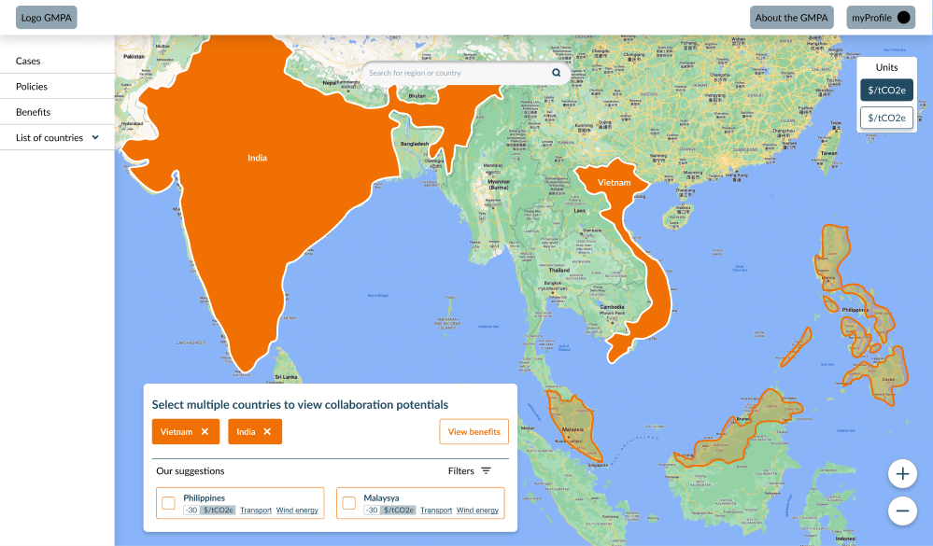
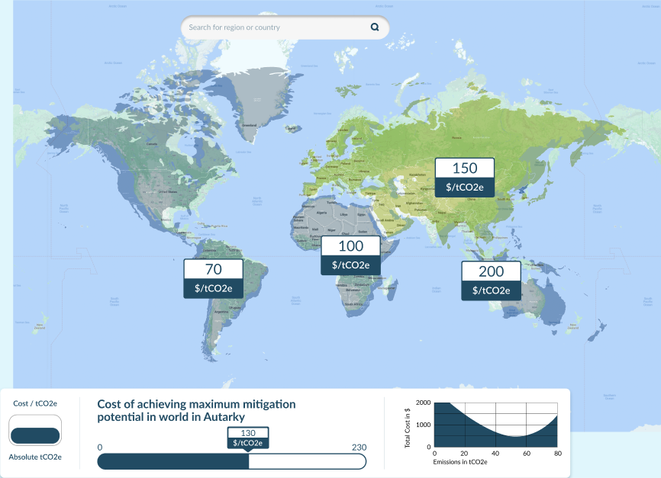
Global mitigation potential atlas
Platform to achieve higher reduction in CO2e emissions
Provide access to country related data
relative and absolute
UX: Interactive Map – zoom, hover, pan, click
Collaboration between Conclusion, Climate Analytics, Singapore, Indonesia
Notes:
https://mitigationatlas.org/

Slide 8
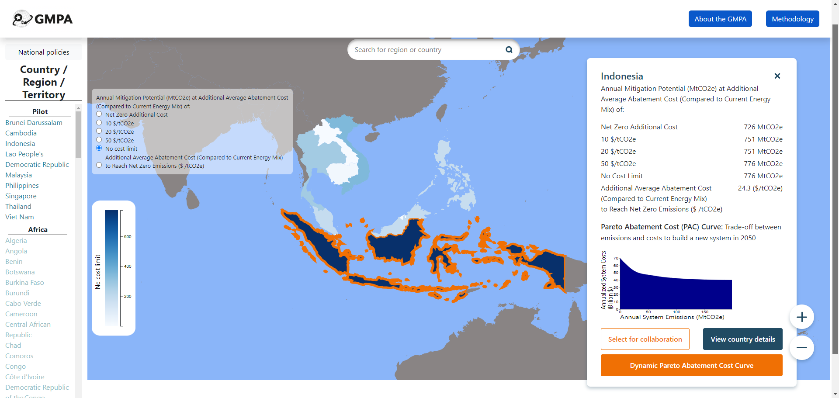
at the heart of GMPA is Chloropleth Map

Slide 9
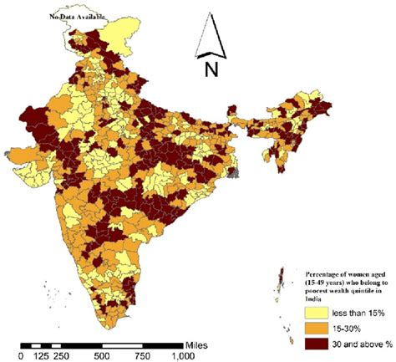
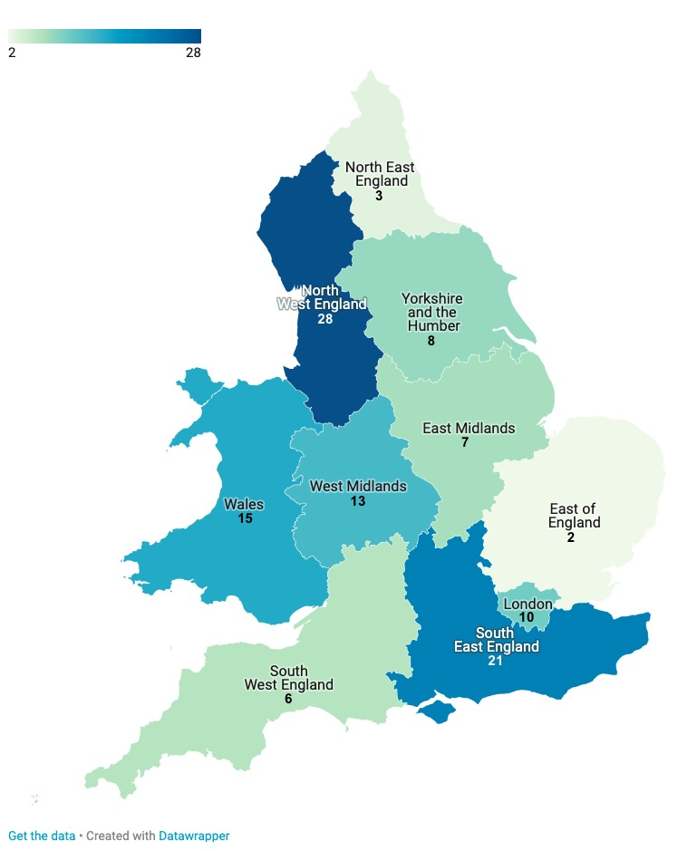
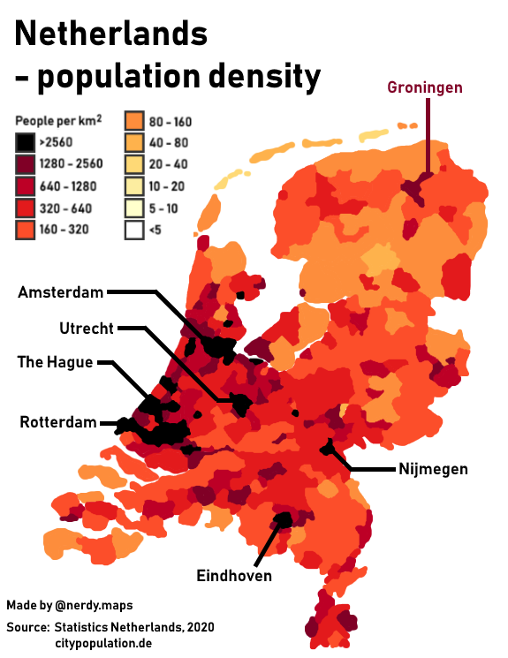
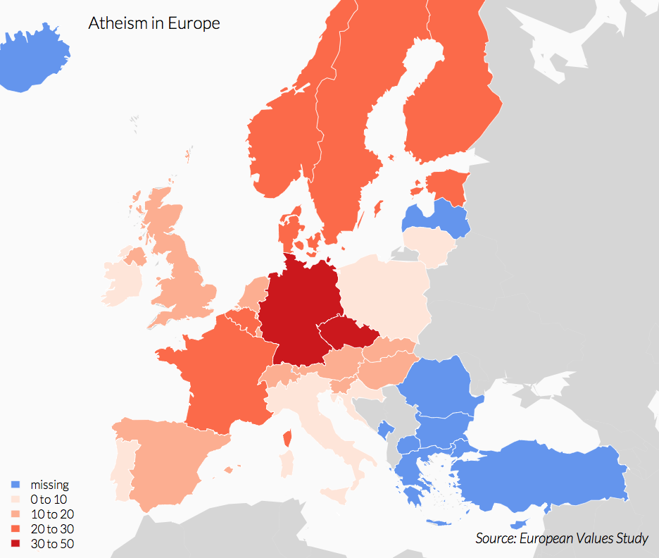
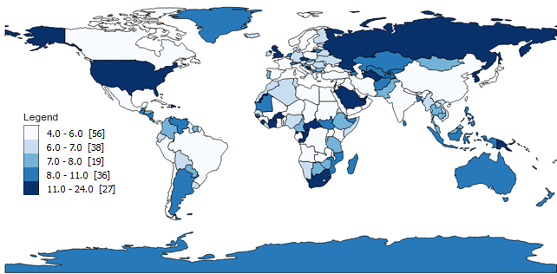
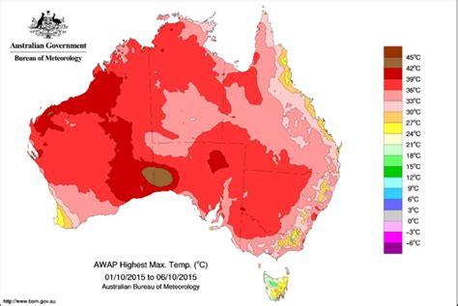
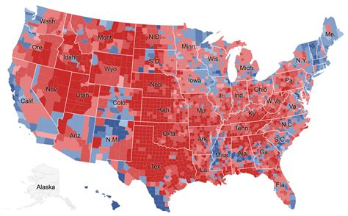
Chloropleth (thematic) Map

Slide 10
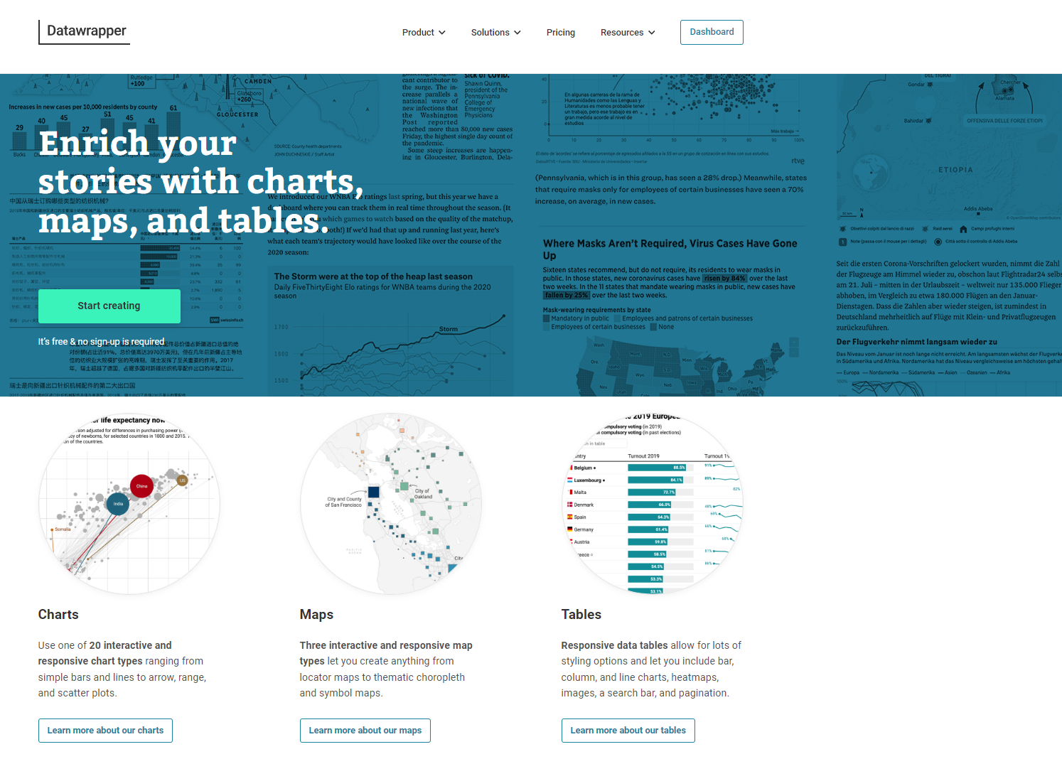
Datawrapper
Introducing Datawrapper
No code data visualization
Free tier
19 types of charts
three types of maps

Slide 11
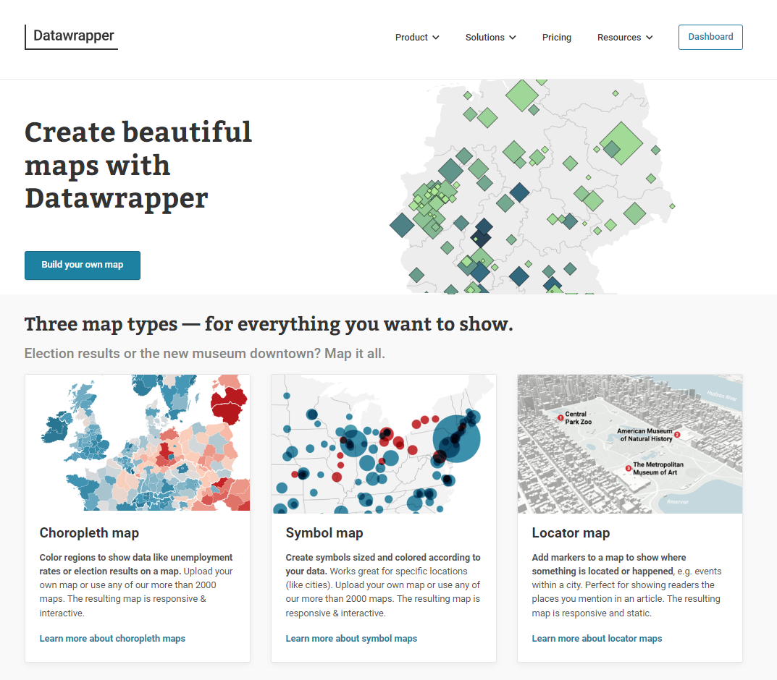
Datawrapper

Slide 12
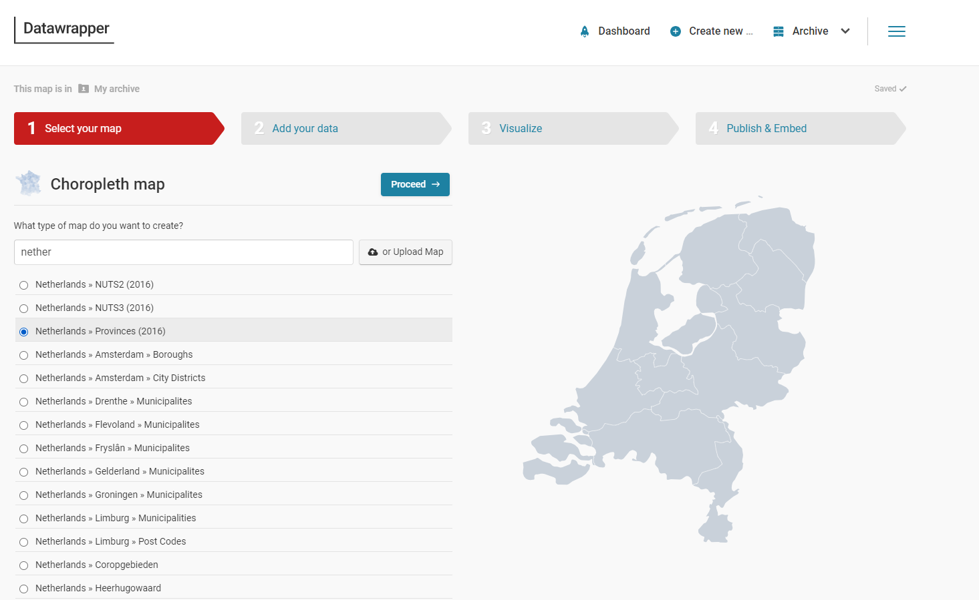
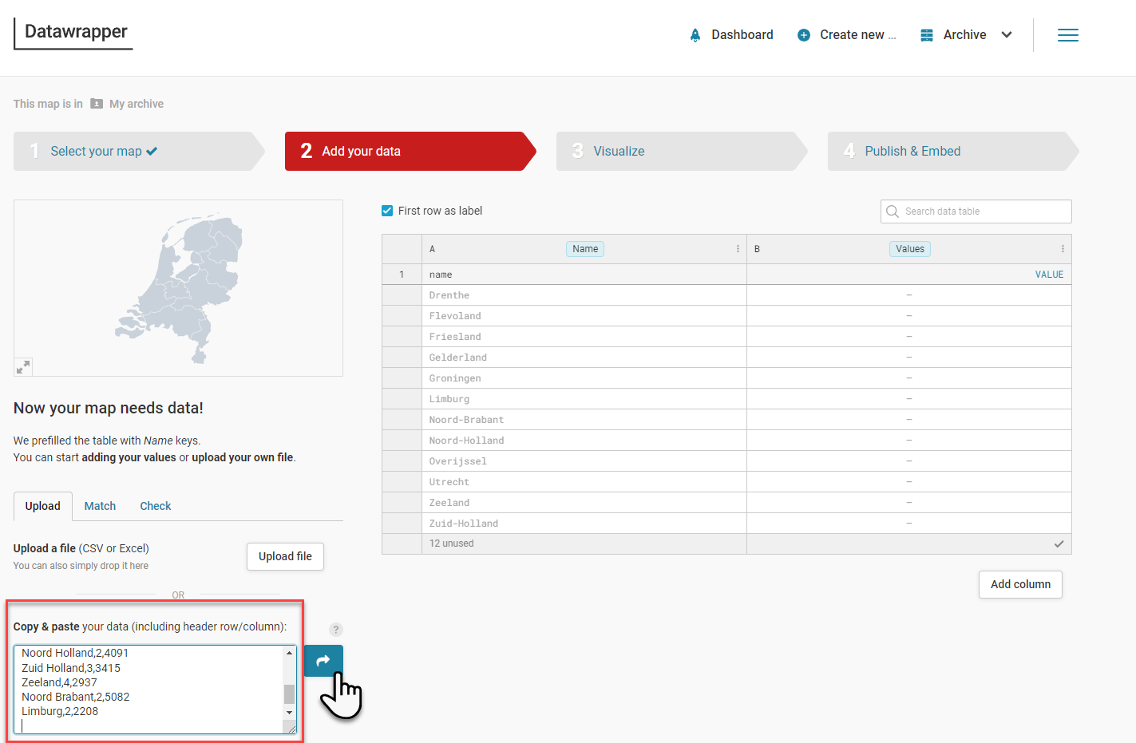
Demo of datawrapper Chloropleth map

Slide 13
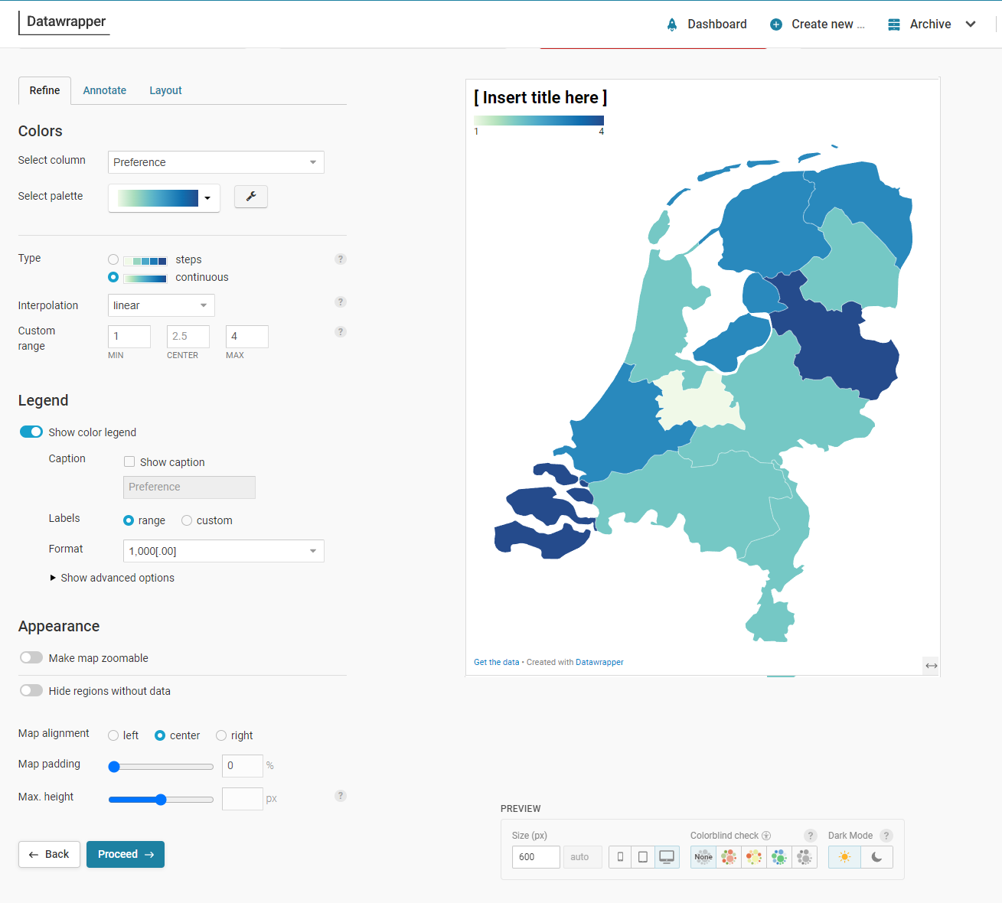
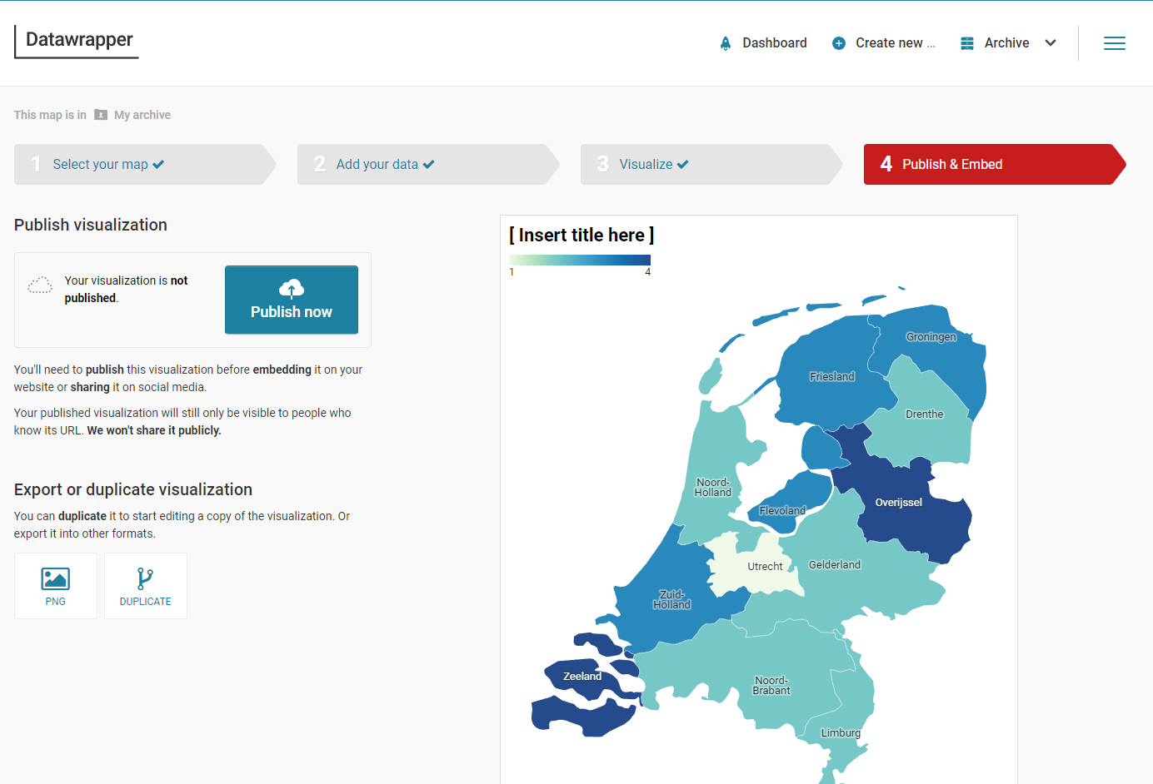
Demo of datawrapper Chloropleth map

Slide 14
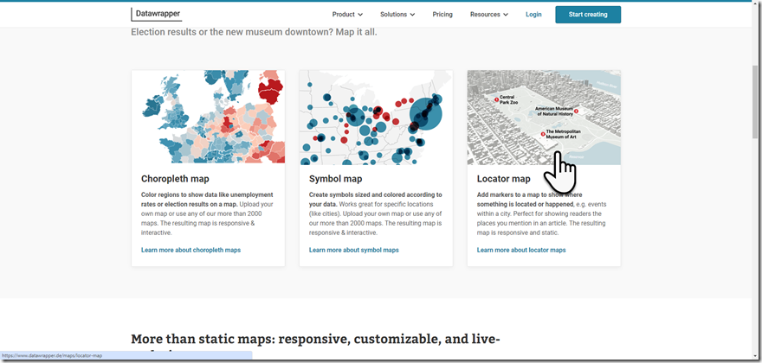
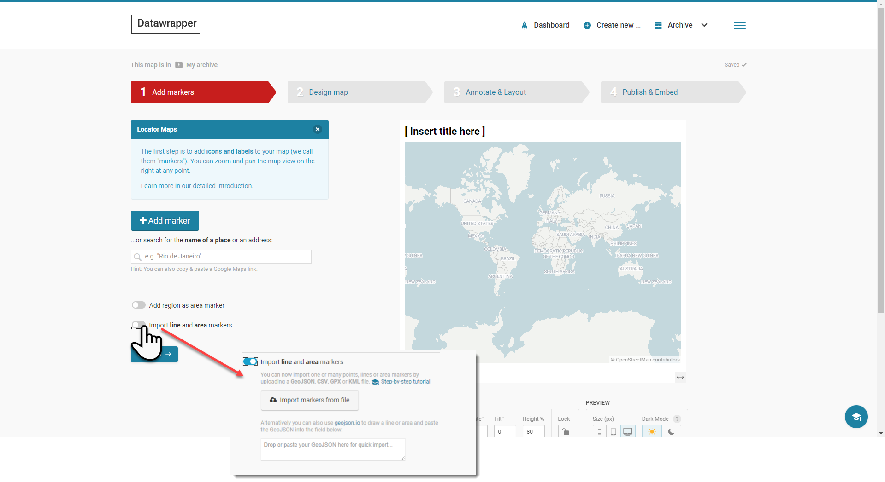
Datawrapper – Locator (Point) map
Show individual locations

Slide 15
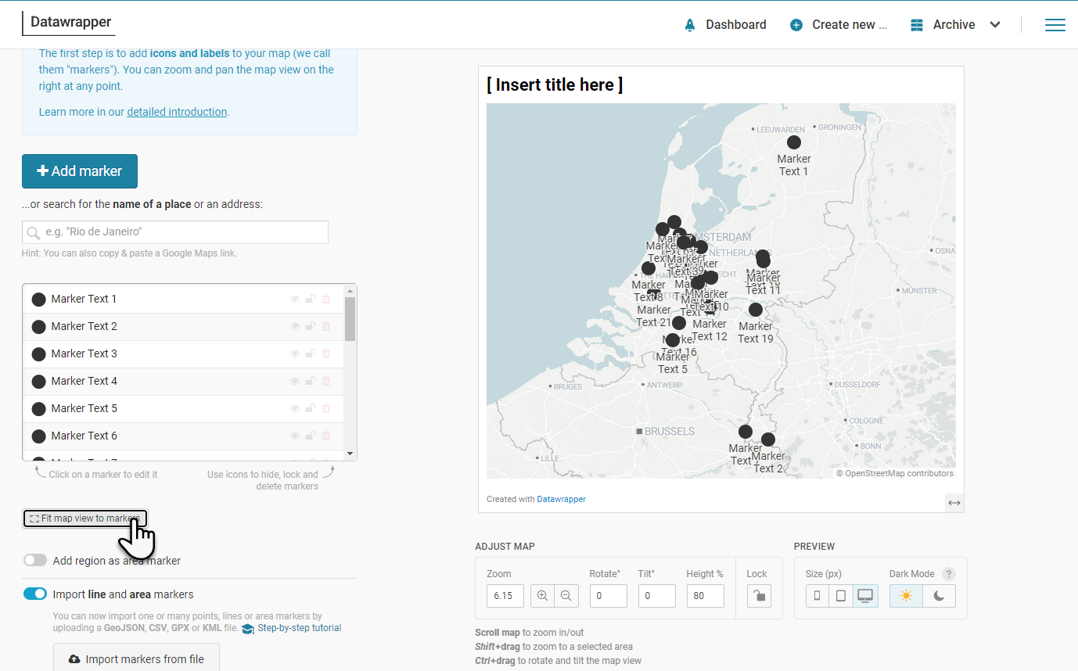
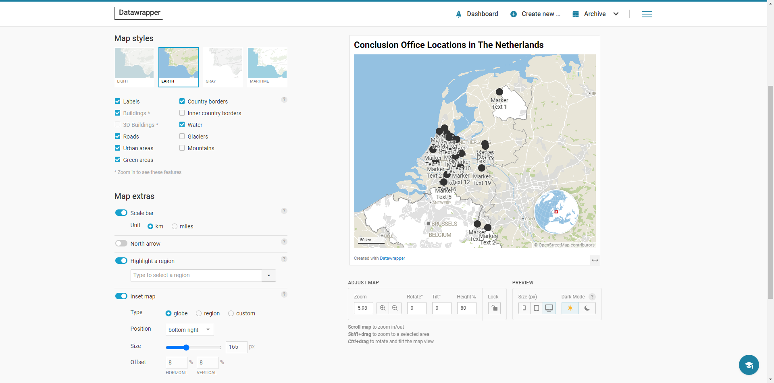
Datawrapper – Locator (Point) map
Show individual locations

Slide 16

Google MyMaps
Create Point Map with custom markers
Import Location data
csv, Google Sheet, WKT, KML/KMZ
Geo Encoding (address to coordinates)
Publish
Export
KML/KMZ
Open in Google Earth
for further embellishment, analysis and export
Notes:
https://support.google.com/mymaps
https://www.google.com/maps/d

Slide 17
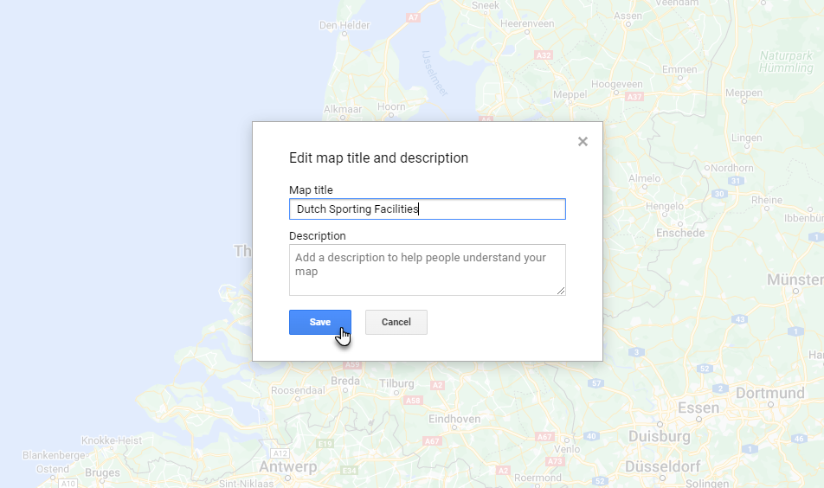
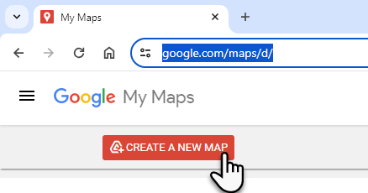
Mymaps

Slide 18
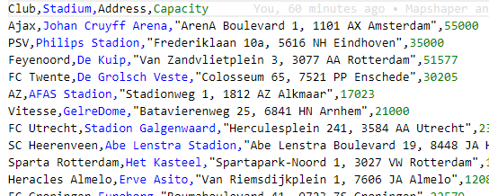
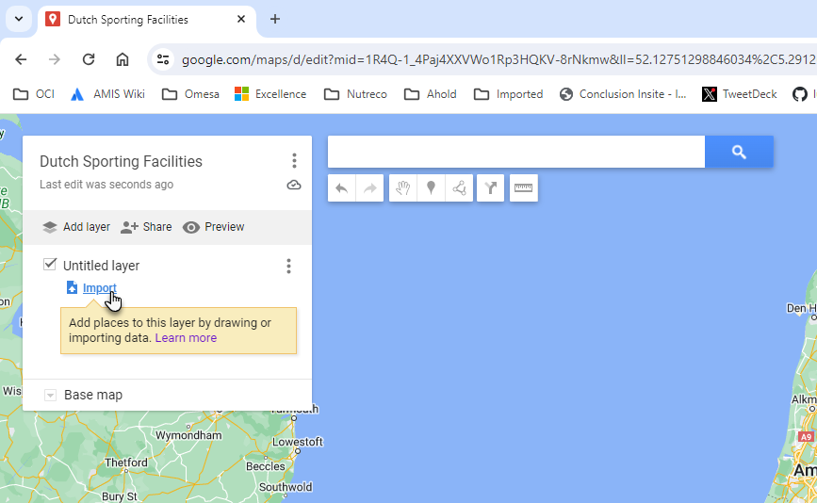
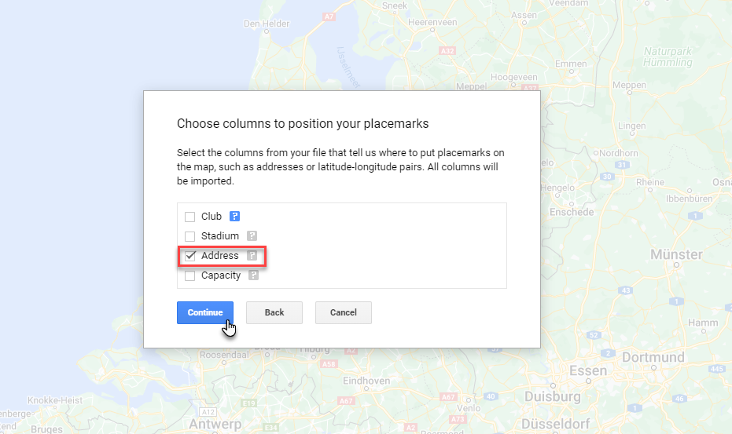
Mymaps

Slide 19
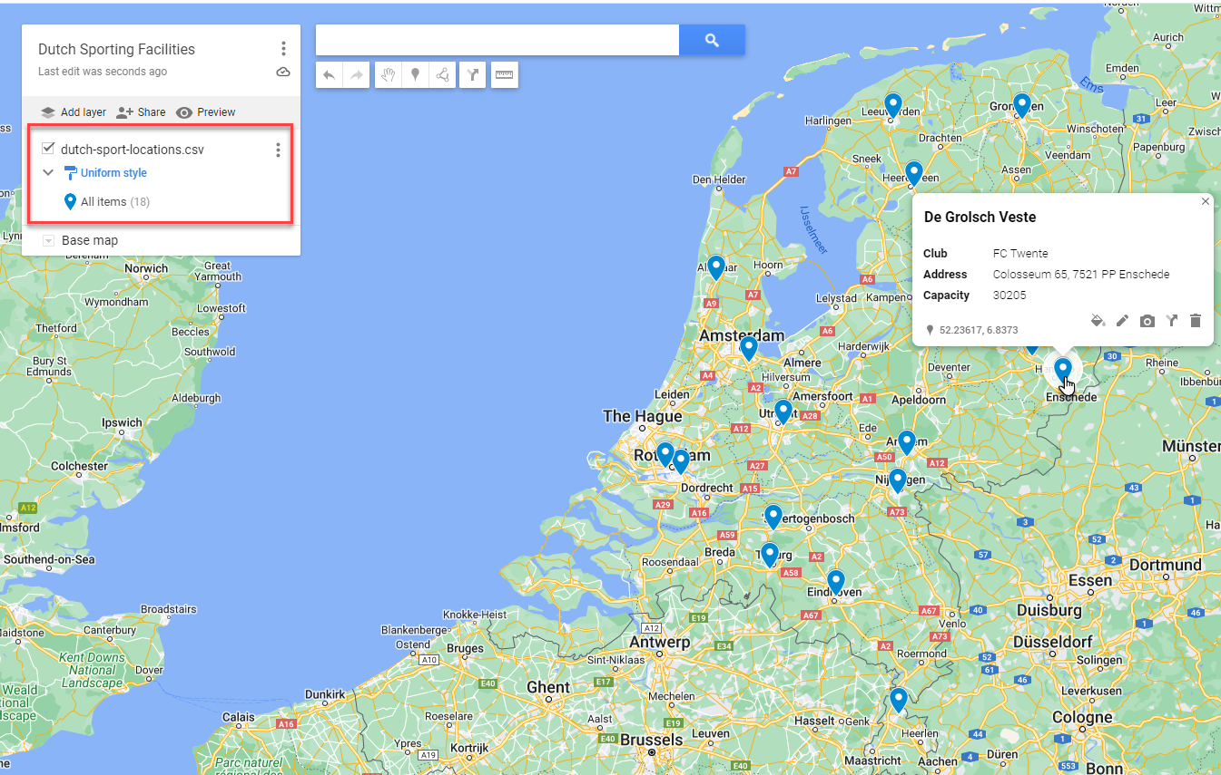
mymaps

Slide 20
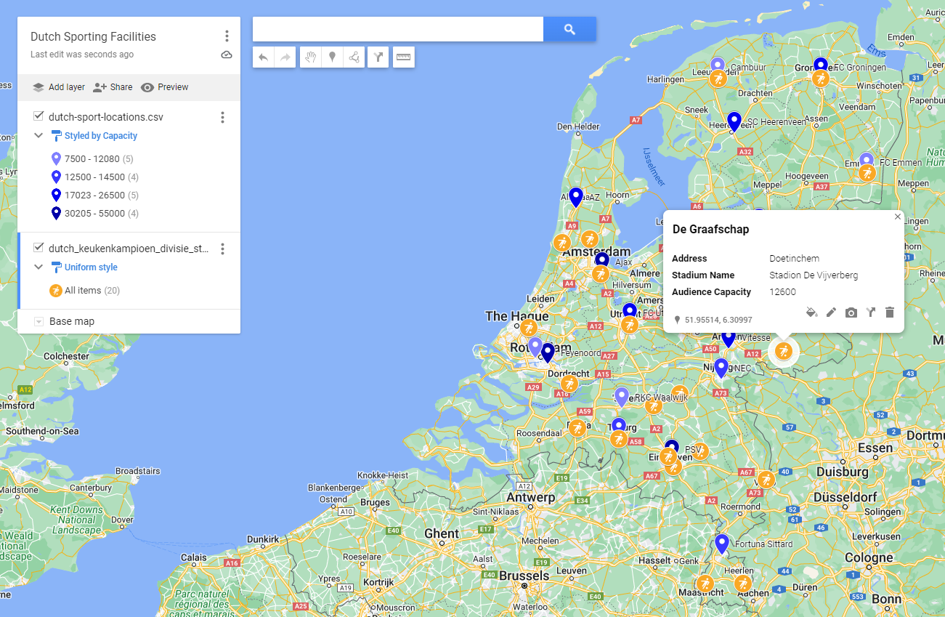
Mymaps – two layers, some styling
Added a second layer
Imported another CSV file
Styled new layer with color and icon

Slide 21
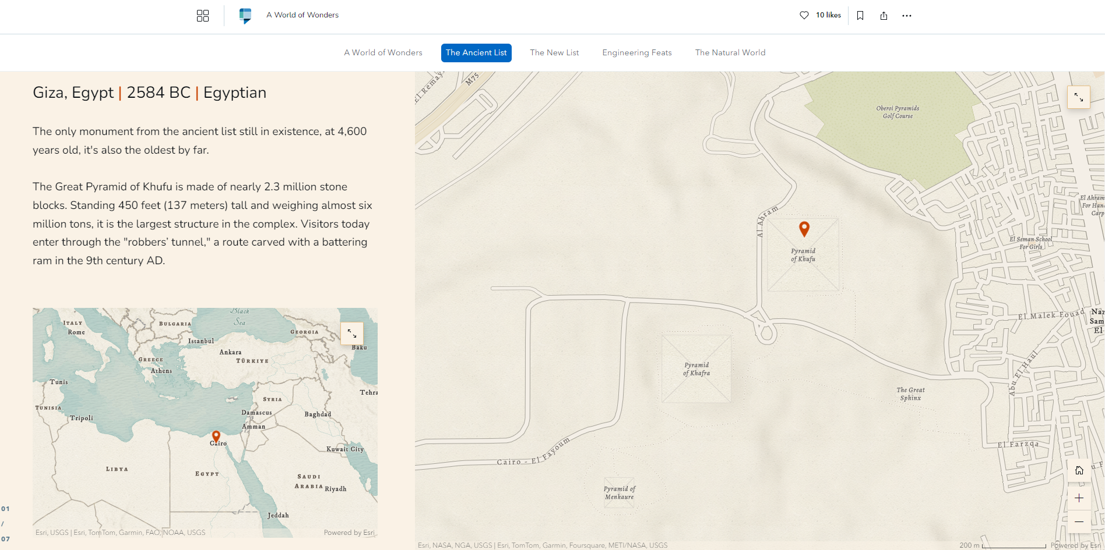
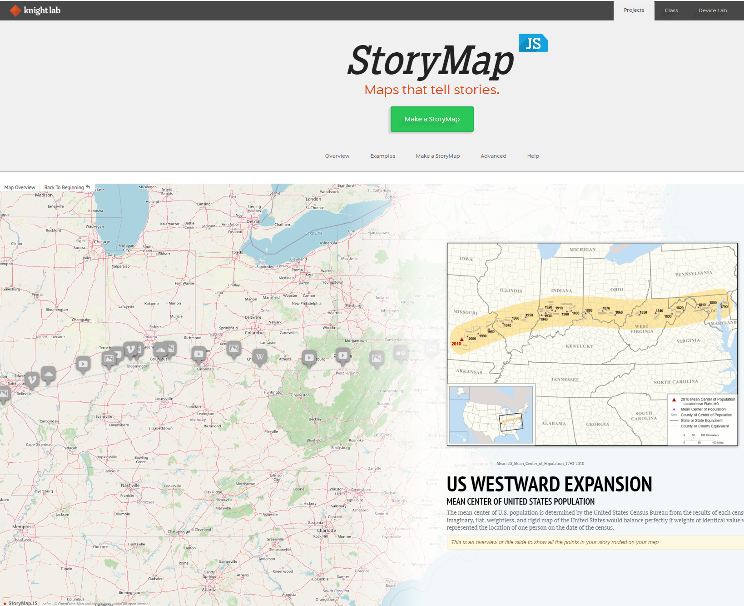
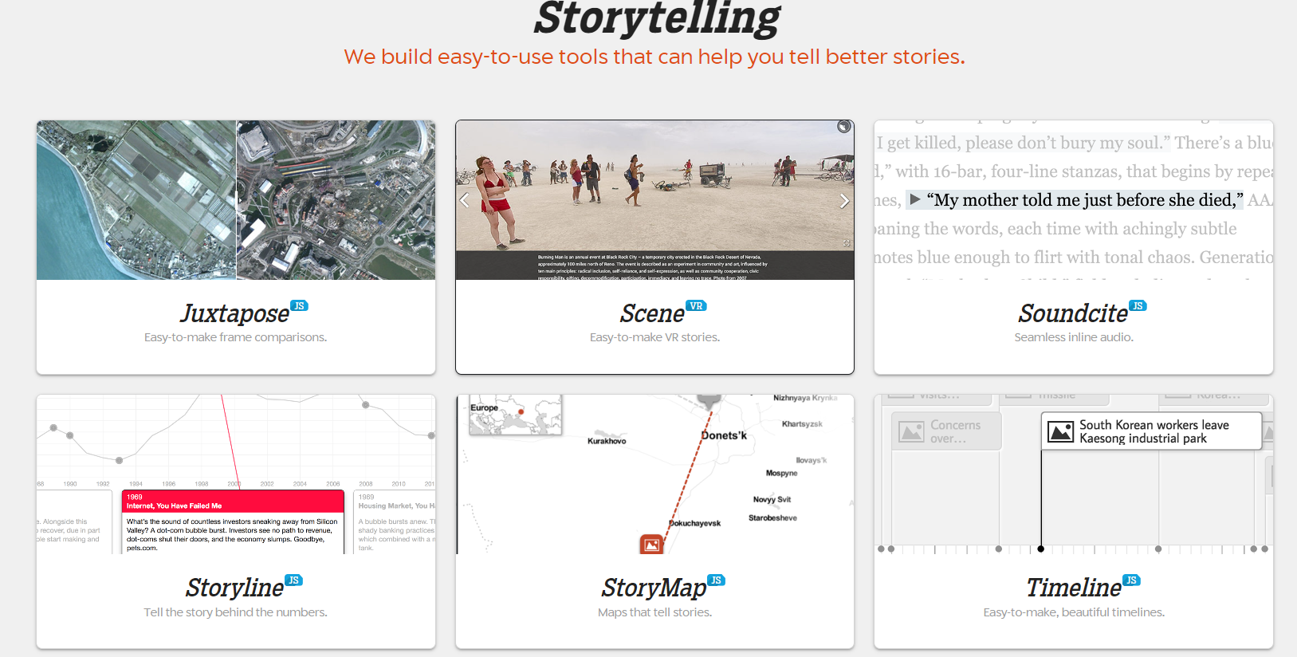
StoryMap JS
StoryMap JS by Northwestern University Knight Lab
StoryMapJS is a free tool to help you tell stories on the web that highlight the locations of a series of events. It is a new tool, yet stable in our development environment, and it has a friendly authoring tool.
Notes:
https://storymaps.com/
https://storymap.knightlab.com/

Slide 22
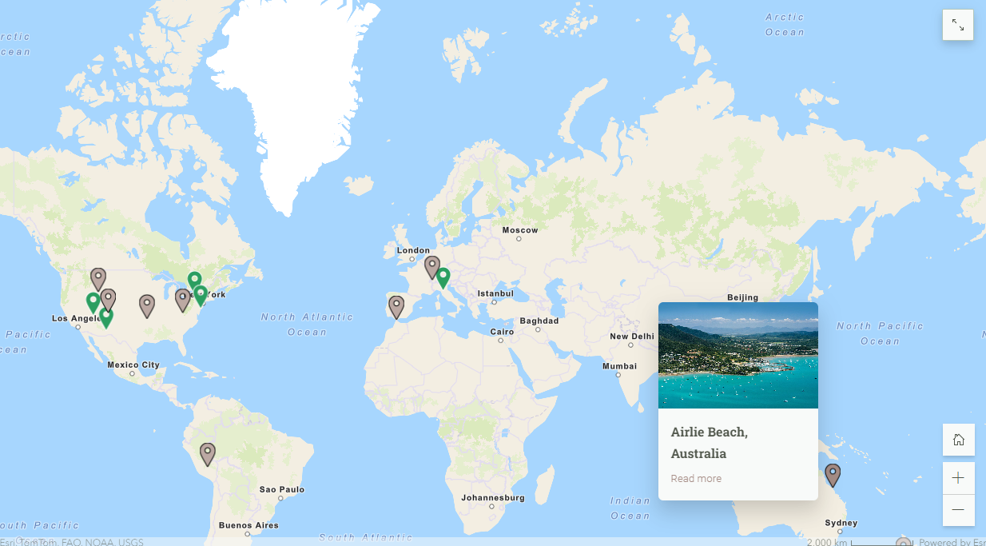
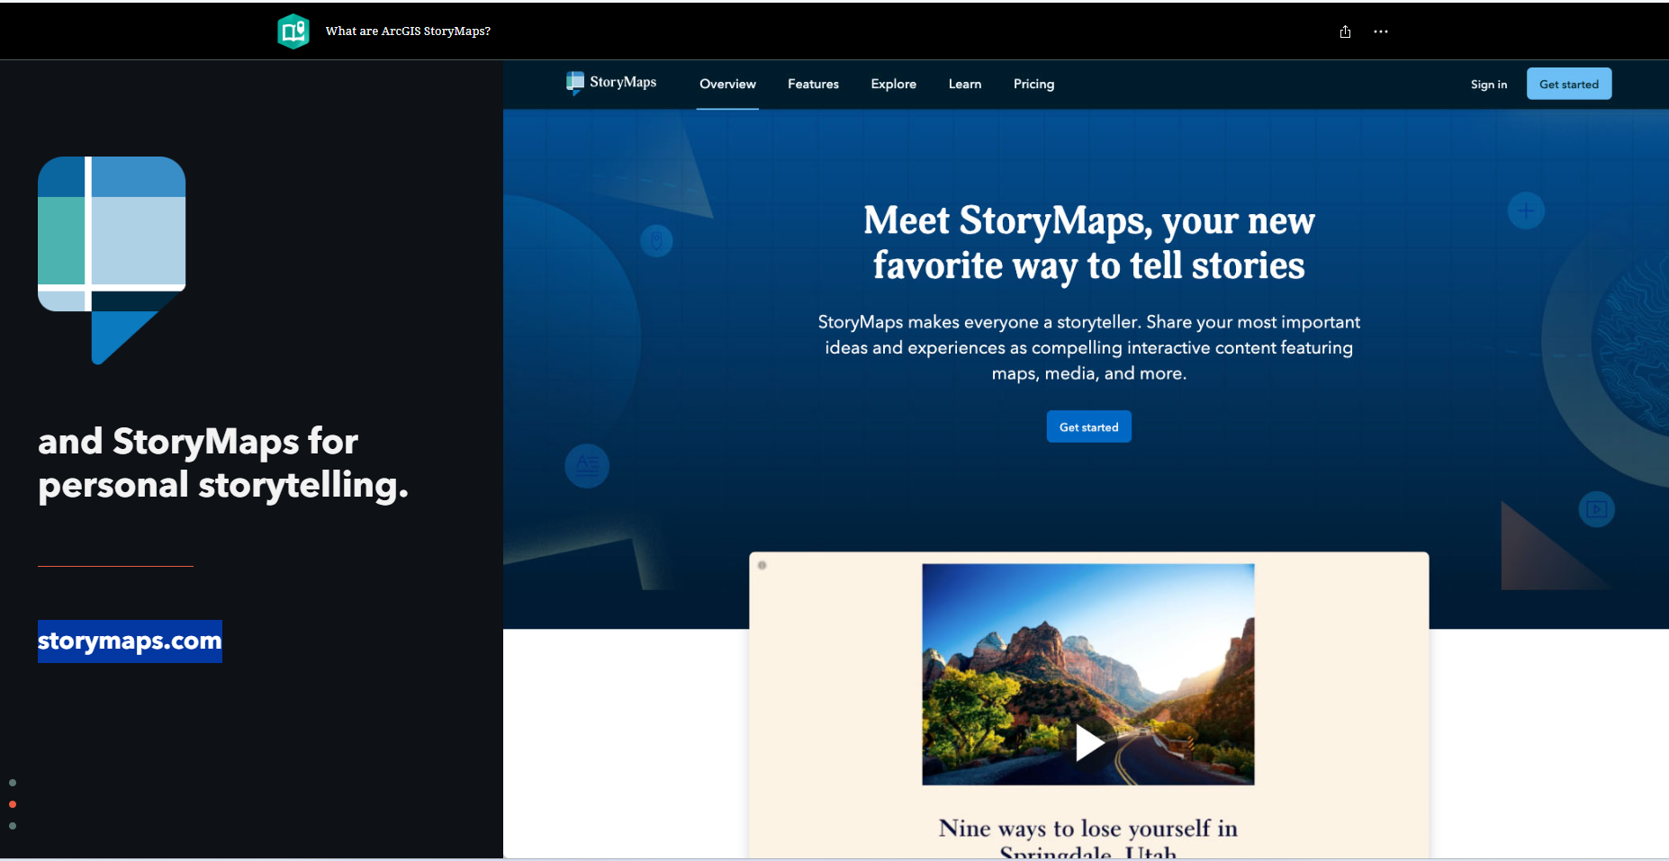
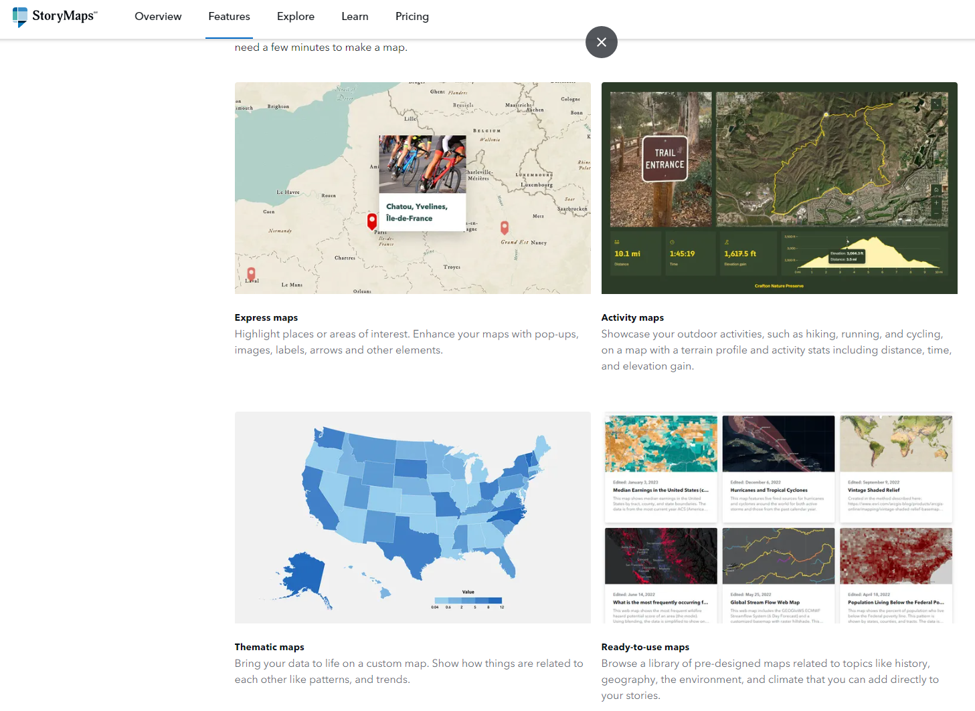
StoryMap
ArcGIS – Story Maps (storymaps.com)
Notes:
https://storymaps.com/
https://storymap.knightlab.com/

Slide 23
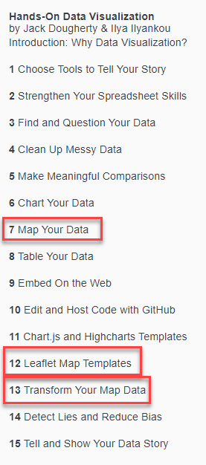

Tip: Hands-on Data visualization
Introduction to many ways of presenting data [stories] in s a visual way
Overview of dozens of [free] tools and web sites for visualizing data
Available online in a free edition: handsondataviz.org/open-access
On Geo Data: Google MyMaps, Map Warper, Data Wrapper, Leaflet, MapShaper, Open Data Sets (Socrata), Tableau Public, Open Street Map, geoJson.io, Gimme Geodata
and supporting tools such as ColorBrewer
Notes:
https://handsondataviz.org/
https://handsondataviz.org/open-access.html
https://hanshack.com/geotools/
https://hanshack.com/geotools/gimmegeodata/

Slide 24
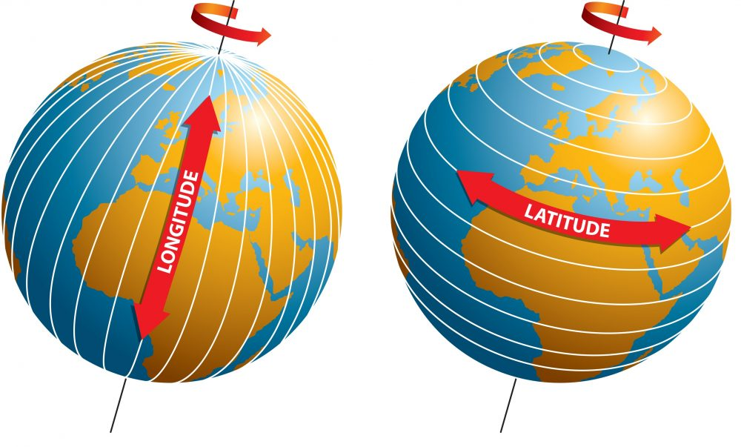
geo coordinates
longitude and latitude
expressed in degrees subdivided in minutes and seconds
sometimes decimal degrees

Slide 25
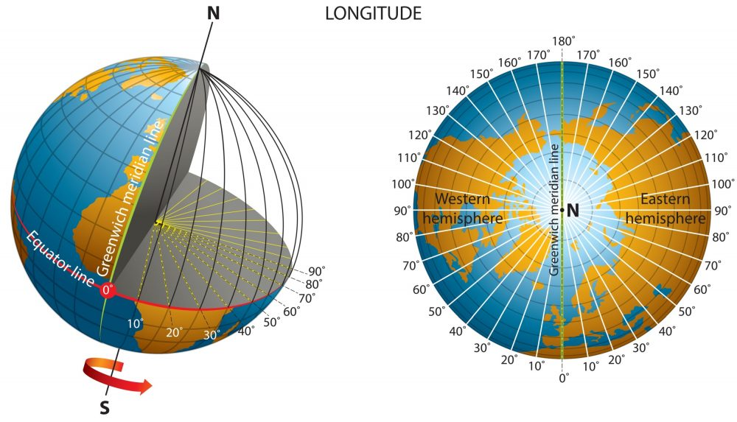
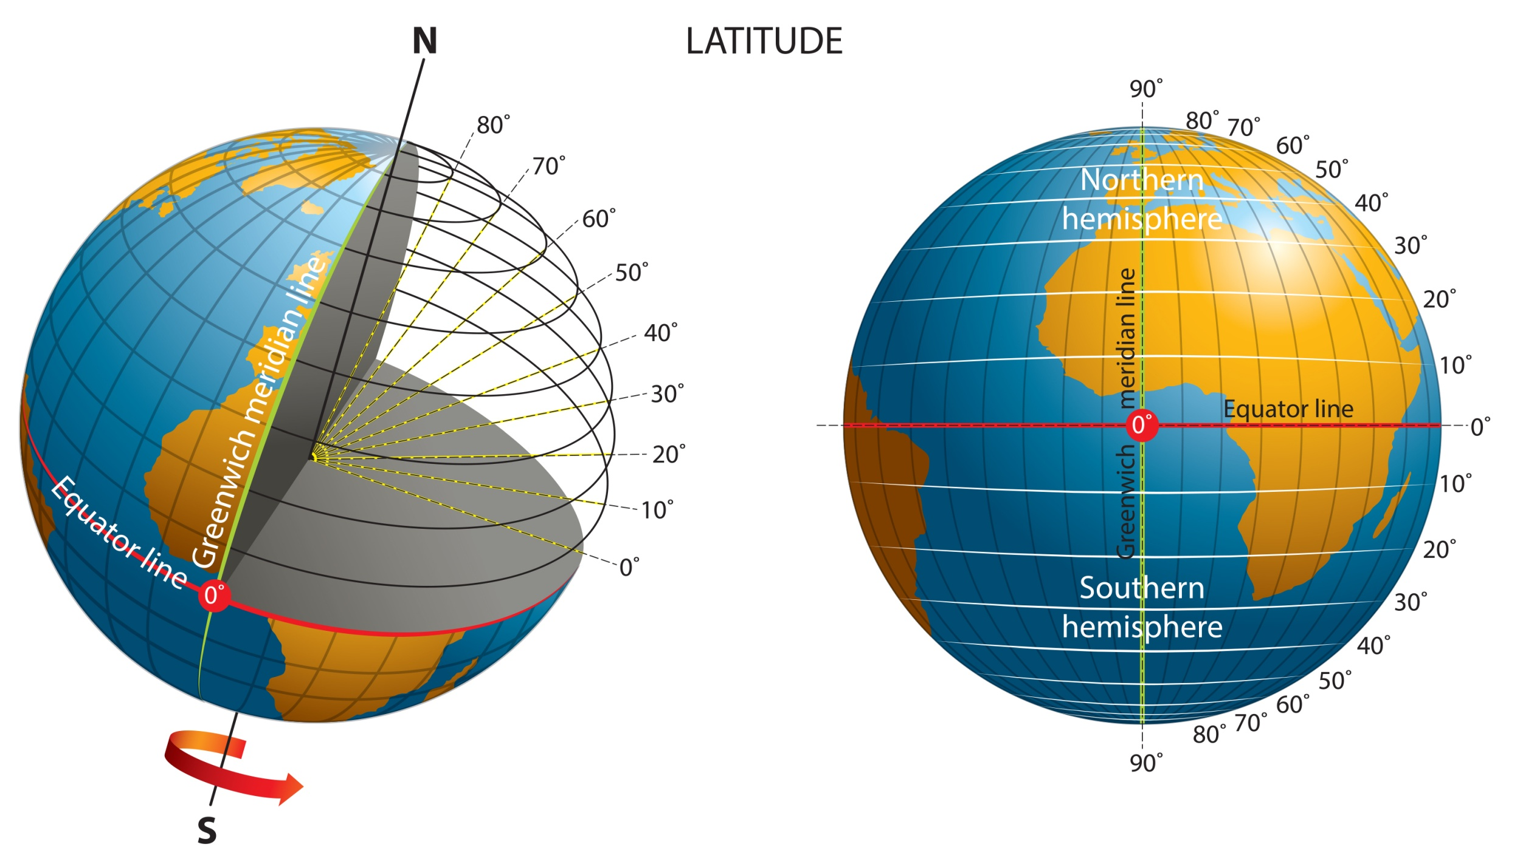
geo coordinates
Eastliness [-180∘, + 180∘]
from Greenwich
North-liness [-90∘, + 90∘]
from equator

Slide 26

Geocoding and Reverse geocoding
Geocoding: find geo coordinates for street addresses
Reverse Geocoding: find address details for geo coordinates

Slide 27

Tools and apis for Geocoding and Reverse geocoding
Many tools and APIs provide geocoding reverse geocoding services
for bulk processing usually a fee is required

Slide 28

Introduction GEOJson
GeoJSON is a format for encoding a variety of geographic data structures (IETF RFC 7946).
It describes the following geometry types: Point, LineString, Polygon, MultiPoint, MultiLineString, and MultiPolygon.
It is a specialized form of JSON
text, human readable and editable
The coordinate reference system for all GeoJSON coordinates is a geographic coordinate reference system, using the World Geodetic System 1984 (WGS 84) datum, with longitude and latitude units of decimal degrees
{
"type": "Feature",
"properties": {},
"geometry": {
"coordinates": [
5.143356750015556,
2.0778195243667
],
"type": "Point"
}
}
Notes:
https://github.com/topojson/topojson

Slide 29

Introduction GEOJson
the coordinates array may contain a third that indicates altitude (aka elevation) in meters
{
"type": "Feature",
"properties": {},
"geometry": {
"coordinates": [
5.143356750015556,
2.0778195243667, 88
],
"type": "Point"
}
}
Notes:
https://github.com/topojson/topojson

Slide 30

Introduction GEOJson
GeoJSON is a format for encoding a variety of geographic data structures (IETF RFC 7946).
It describes the following geometry types: Point, LineString, Polygon, MultiPoint, MultiLineString, and MultiPolygon.
It is a specialized form of JSON
text, human readable and editable
{
"type": "Feature",
"properties": {},
"geometry": {
"coordinates":
[
[ 5.14341766, 52.0778029], [ 5.14370614, 52.0779004], [ 5.14379268, 52.0783791],
[ 5.14393693, 52.0787603],
[ 5.13998470, 52.07981525]
],
"type": "LineString"
}
}
Notes:
https://github.com/topojson/topojson

Slide 31

Introduction GEOJson
GeoJSON is a format for encoding a variety of geographic data structures (IETF RFC 7946).
It describes the following geometry types: Point, LineString, Polygon, MultiPoint, MultiLineString, and MultiPolygon.
It is a specialized form of JSON
text, human readable and editable
TopoJSON is smartly compressed GeoJSON
e.g. removes duplication such as a doubly included shared border
{
"type": "Feature",
"properties": {},
"geometry": {
"coordinates":
[
[ 5.1461294, 52.078813],
[ 5.1451485, 52.0790354],
[ 5.1444273, 52.078210],
[ 5.1453649, 52.076969],
[ 5.1475285, 52.077244],
[ 5.1482064, 52.0782016] ],
"type": "Polygon"
}
}
Notes:
https://github.com/topojson/topojson

Slide 32

Introduction GEOJson
{
"type": "FeatureCollection",
"features": [
{
"type": "Feature",
"properties": {},
"geometry": {
"coordinates": [
5.143143, 52.077802
],
"type": "Point"
}
},
{
"type": "Feature",
"properties": {},
"geometry": {
"coordinates": [
5.13999, 52.0797708
],
"type": "Point"
}
}
]
}
A GeoJSON Document consists of a Feature Collection object that contains one or multiple Features
Note: TopoJSON is smartly compressed GeoJSON
e.g. removes duplication such as a doubly included shared border
Notes:
https://github.com/topojson/topojson

Slide 33

geojson.io
Online tool (free) to visualize, edit and compose GeoJSON data set
upload or paste GeoJSON (or other Geo Data) to have it visualized
create points, lines and polygons on a map – thereby creating GeoJSON

Slide 34

geojson.io

Slide 35


geojson.io

Slide 36


Gimme geodata
Click on location
Download GeoJSON boundary file for any area the location is part of
municipality, province, state, country, “waterschap”, tourist attraction, police region
Use GeoJSON for whatever fun you want to have
hanshack.com/geotools/gimmegeodata/
Notes:
https://hanshack.com/geotools/gimmegeodata/

Slide 37

Datawrapper – pointmap from geojson
Datawrapper processes GeoJSON data – speeding up the creation of point maps
many markers can be created from a single file
Google MyMaps cannot load GeoJSON directly
if we can convert GeoJSON to KML/KMZ, then we are good – let’s talk formats and then conversion
tool tip: mapshaper.org

Slide 38



vector and raster
Vector: instructions for drawing elements
Raster: pixels that visualize everything

Slide 39

Maps – vector vs raster
GeoData Vector:
describe points, lines, areas (boundaries) in terms of geo-coordinates with associated meta-data
formats: GeoJSON, TopoJSON, KML/KMZ (Google), Shape File (Esri), GML (XML extension), OSM (PBF), GPX (GPS XML), CSV
GeoData Raster:
visualize geo information associated with geo-coordinates using pixels
formats/protocols: WMS, Geo TIFF, Esri Grid, MBTiles, regular image formats JPEG, PNG, ..
Notes:
other vector: KML/KMZ (Google), WMS, Shape File (Esri), GML (XML extension), OSM (PBF)
raster: Geo TIFF, Esri Grid,

Slide 40



Tiles
Notes:
Map tiles are squares of geographic data that are loaded to your frame of view whenever you zoom or pan your map. Each tile is 256px by 256px (traditionally a .png image at roughly 20-40kb each),

Slide 41

Tiles
Tiles are usually 256 x 256 pixels, PNG, 20-40kb
Notes:
Map tiles are squares of geographic data that are loaded to your frame of view whenever you zoom or pan your map. Each tile is 256px by 256px (traditionally a .png image at roughly 20-40kb each),
https://ubc-library-rc.github.io/gis-intro-leaflet/content/map-tiles.html

Slide 42

map services – exposing raster tiles
Open Street Map
Google
Bing Maps
MapTiler
Stamen
MapBox
Thunderforest
custom hosted
MapBox Studio – create custom maps, export vector or tile format, host on MapBox or DIY
open source: TileMill (discontinued?), Maputnik, QGIS
commercial: ArcGIS, CARTO Builder

Slide 43


Map Shaper – convert formats … and more
Import
upload file, paste geo data
Visualize
Edit
Simplify
Project
Convert and Export

Slide 44






Map Shaper
Import
upload file, paste geo data
Visualize
Edit (filter/combine/remove/clip/…)
programmatically in console
Simplify
Project
Convert and Export

Slide 45

Geo Sentences – smart geojson editing
mapshaper with pretty ui
Notes:
https://hanshack.com/geotools/geosentences/

Slide 46

Geotools
Notes:
https://hanshack.com/geotools/

Slide 47






public Geo data sets
Data that is associated with administrative units that can be visualized on a map
statistics per street | area | city | province/state | country | continent
politic (election), economic, demographic, cultural, …
Data for a location or area: measurements, characteristics
altitude, vegetation, fauna, soil, temperature, ..
Vector Maps – visualizing localized shapes
GeoJSON polyline shapes of geographical region boundaries (geojson-maps.ash.ms/, Gimme Geodata)
ProRail vector data for all Dutch rail infrastructure, Rijkswaterstaat vector data for highways
Raster Maps – visualizing areas in pixels
Notes:
https://academy.datawrapper.de/article/291-how-to-find-geodata
https://cartomap.github.io/nl/
https://www.imergis.nl/htm/rasterkaarten.htm
https://cartographyvectors.com/
Referentie-ondergrond (water, terrein, wegen) gerasterd uit de Basisregistratie Topografie (BRT). (http://www.kadaster.nl) Inhoud is beschikbaar onder de CC-BY licentie.
Gebouwen en woonplaatsgrenzen uit de Basisregistratie Adressen en Gebouwen (BAG), CC-BY Kadaster.
Wegen uit de OpenStreetMap (OSM), CC-BY OpenStreetMap Contributors.
Schaduwreliëf uit het Actuele Hoogtebestand 2 (AHN2), CC-BY Waterschapshuis.
Vectorgrenzen van Veiligheidsregio's worden bijgehouden door Imergis, CC-BY.
BRZO risicolocaties, LPG risicolocaties, buisleidingen: op basis van de Risicokaart, http://nederland.risicokaart.nl.
Locaties van brandweerkazernes en ambulanceposten worden continu aangedragen door informatiemanagers uit de brandweerregio's en GHOR/RAV regio's, en leden van het hulpverleningsforum.nl (crowd sourcing).
Grenzen en kazernes in Duitsland en België vrij ter beschikking gesteld met dank aan Meldkamer Oost Nederland, Regio Limburg-Noord en Regio Midden- en West-Brabant.
Defensie locaties op basis van de lijst op www.marketingfacts.nl.
Locaties C2000 masten op basis van www.c2000masten.nl

Slide 48

Dutch government open geodata

Slide 49



Slide 50



Slide 51

WMS Service connected in QGIS

Slide 52

public Geo data sets – some URLs
https://www.pdok.nl/
https://ec.europa.eu/eurostat/web/gisco/geodata/reference-data
https://data.un.org/
https://datacatalog.worldbank.org/home
https://www.opendatanetwork.com/
https://cartographyvectors.com/
https://gadm.org/ - maps and spatial data for Administrative Units
Notes:
https://academy.datawrapper.de/article/291-how-to-find-geodata
https://cartomap.github.io/nl/
https://www.imergis.nl/htm/rasterkaarten.htm
https://cartographyvectors.com/
Referentie-ondergrond (water, terrein, wegen) gerasterd uit de Basisregistratie Topografie (BRT). (http://www.kadaster.nl) Inhoud is beschikbaar onder de CC-BY licentie.
Gebouwen en woonplaatsgrenzen uit de Basisregistratie Adressen en Gebouwen (BAG), CC-BY Kadaster.
Wegen uit de OpenStreetMap (OSM), CC-BY OpenStreetMap Contributors.
Schaduwreliëf uit het Actuele Hoogtebestand 2 (AHN2), CC-BY Waterschapshuis.
Vectorgrenzen van Veiligheidsregio's worden bijgehouden door Imergis, CC-BY.
BRZO risicolocaties, LPG risicolocaties, buisleidingen: op basis van de Risicokaart, http://nederland.risicokaart.nl.
Locaties van brandweerkazernes en ambulanceposten worden continu aangedragen door informatiemanagers uit de brandweerregio's en GHOR/RAV regio's, en leden van het hulpverleningsforum.nl (crowd sourcing).
Grenzen en kazernes in Duitsland en België vrij ter beschikking gesteld met dank aan Meldkamer Oost Nederland, Regio Limburg-Noord en Regio Midden- en West-Brabant.
Defensie locaties op basis van de lijst op www.marketingfacts.nl.
Locaties C2000 masten op basis van www.c2000masten.nl

Slide 53
Agenda
Why?
Simple Maps, simple tools
Chloropleth, Point Map using Data Wrapper, Google MyMaps and StoryMap
Geo Data – coordinates, format and tool: geojson.io
Geo Data Sets – publicly available
Socrata Open Data Sets, PDOK, United Nations, Eurostat, Dutch CBS and Nationaal GeoRegister, ProRail
MapShaper for converting formats, inspecting and manipulating data
MapWarper – for georectifying custom images of maps (historic, fantasy or otherwise)
QGIS – geo data scientist’s workbench (all of the above and more)
Integrating custom, interactive, dynamic in web applications using Leaflet and OpenStreetMap
demonstration of Conclusion FotoMapp
Notes:
MapWarper and QGIS https://spacetime.nypl.org/qgis-trace-tutorial/ - load georectified historical map as WMS Layer from WMS Capabilties URL in MapWarper
https://gisgeography.com/gis-formats/

Slide 54

mapwarper
turn images that can be mapped to geo coordinates into tiles served by WMS or Tiles service
or exported to KML/KMZ, GeoTiff, PNG
mapwarper.net
Notes:
https://www.mapwarper.net/

Slide 55

mapwarper
often used for historic maps to be layered on top of current base layers
use for example in geojson.io, QGIS, Google Earth and with Leaflet

Slide 56

QGIS
Desktop Tool for Geo Data
analysis, manipulation, visualization, conversion
it is a combination of all previously discussed tools (and more)
For Geo Data Scientists
1GB Installation (!)
First release: 2002
Technology: primarily C++ and Python

Slide 57







export
import

Slide 58


Multiple layers including warped map

Slide 59


qgis – inspecting GADM
Notes:
https://gadm.org/download_country.html

Slide 60



Slide 61


Slide 62



Slide 63



Slide 64


leaflet
Leaflet is the leading open-source JavaScript library for mobile-friendly interactive maps.
Weighing just about 42 KB of JS, it has all the mapping features most developers ever need.
markers, zoom, pan, interactivity, popup, layers, WARPed tile layers, images, video, GeoJSON, SVG, non-earthbound-maps, ..
add integrated, dynamic and interactive geodata on maps to any web or mobile app
Web App
(React, Angular, Vue,
Svelte, vanilla JS, …
JS & CSS

Slide 65
Oliver Heesakkers – Check The Beat 2.0
Web Application used by Conclusion Mission Critical and ProRail to identify and visualize railway stations with current incidents

Slide 66

fotomapp

Slide 67

fotomapp
Upload or paste photographs
these are scanned for timestamp and Geo Coordinates and turned into map markers
the marker popup shows details and picture
Each marker is reverse Geocode: the address details are looked up and added
All regular Leaflet map functionality is supported: zoom, pan, hide/show layers
GeoJSON and Google Maps coordinates can be pasted and custom markers can be click-added to the map
Markers can be moved, deleted, edited (label, description, style, tooltip) and consolidated
Filtering by timestamp
WARPed tile layers can be added
Map can be exported as image and as GeoJSON – for example for Datawrapper
Note: all data is stored locally (inside your browser)
no one can access the data. you can only access your own data using the same browser.
lucasjellema.github.io/foto-map/
Notes:
https://lucasjellema.github.io/foto-map/

Slide 68

Leaflet Introduction
Start with a normal web application (or even a simple index.html file)
Import Leaflet Stylesheet and JavaScript library
Define a map container (a DIV element) with appropriate width and height
Add a few lines of JavaScript
create the map – centered on a specific set of coordinates with a zoom level
add a tile layer to show a map – usually OpenStreetMap
optionally: add one or more markers
then perhaps: define popup, load GeoJSON and turn into markers, add lines/areas

Slide 69
Logo
www.conclusion.nl

